Slide 1

Senior Design Project Review
Hybrid Deep Learning and Quantum Machine Learning Approach for Accurate Polyp Segmentation in Colonoscopy Images
SDP ID: 20251390
Presented By:
Name of the Student(s) with Regd. No.:
VANAMA DHHANUSH - 22BCE7763
APPANA SATYA SAHIL – 22BCE7317
PALNATI VIKAS – 22BCE7817
SCOPE
VIT-AP University,
Amravati, India
‹#›

Slide 2
Presentation Outline
Introduction
Project Overview and Problem Statement
Motivations
Background & Related Work/ Literature Review
Existing Solutions / Literature Survey
Gaps Identified / Improvements Over Existing Solutions
Project Objectives
Proposed Solution
System Architecture /Workflow Diagram /Model Diagram /Block Diagram/UML diagrams
Key Components/Features/Modules
Algorithms Used/Technologies, Frameworks, and Tools Used
Simulation and Results
Summary ( Findings, Limitations, Future Directions )
References
‹#›

Slide 3
Introduction
Project Overview
The project focuses on developing a hybrid Deep Learning and Quantum Machine Learning framework for automated polyp segmentation in colonoscopy images. The system combines the spatial feature extraction capability of U-Net with the enhanced feature representation capability of Quantum Machine Learning.
Problem Statement
Manual polyp detection is time-consuming, error-prone, clinician dependent.
Colonoscopy images contain challenges such as irregular polyp shapes, low contrast, noise and illumination variations, complex textures.
‹#›

Slide 4
Introduction
Motivations
Rising cases of colorectal cancer globally.
Need for early and accurate diagnosis.
Reduction of diagnostic errors in clinical practice.
Improvement of computer-aided diagnosis systems.
Advancement in medical image segmentation using AI.
Potential of Quantum Machine Learning in healthcare applications.
Need for robust models capable of handling complex medical imaging scenarios.
Development of next-generation intelligent healthcare systems.
‹#›

Slide 5
Background & Related Work / Literature Review
Existing Solutions / Literature Survey
Deep Learning in Medical Imaging
U-Net Architecture
Quantum Machine Learning
Previous Research
U-Net for biomedical segmentation
Deep CNNs for polyp detection
Quantum-enhanced feature learning
Deep learning healthcare diagnostic systems
‹#›

Slide 6
Background & Related Work / Literature Review
Gaps Identified / Improvements over Existing Solutions
Existing models struggle with:
Complex polyp boundaries
Low contrast images
Irregular textures
Generalization across datasets
Classical deep learning methods:
Cannot fully capture complex feature relationships
Have limited robustness under varying imaging conditions
Traditional systems have:
Higher false positives and false negatives
Reduced segmentation precision
‹#›

Slide 7
Project Objectives
To develop a hybrid Deep Learning and Quantum Machine Learning framework for accurate polyp segmentation in colonoscopy images.
Preprocess colonoscopy image datasets and to perform automated image segmentation using U-Net.
Integrate Quantum Machine Learning layer and improve Dice score, IoU, and pixel accuracy.
Reduce dependency on manual diagnosis.
Build a scalable and intelligent healthcare diagnostic system.
‹#›

Slide 8
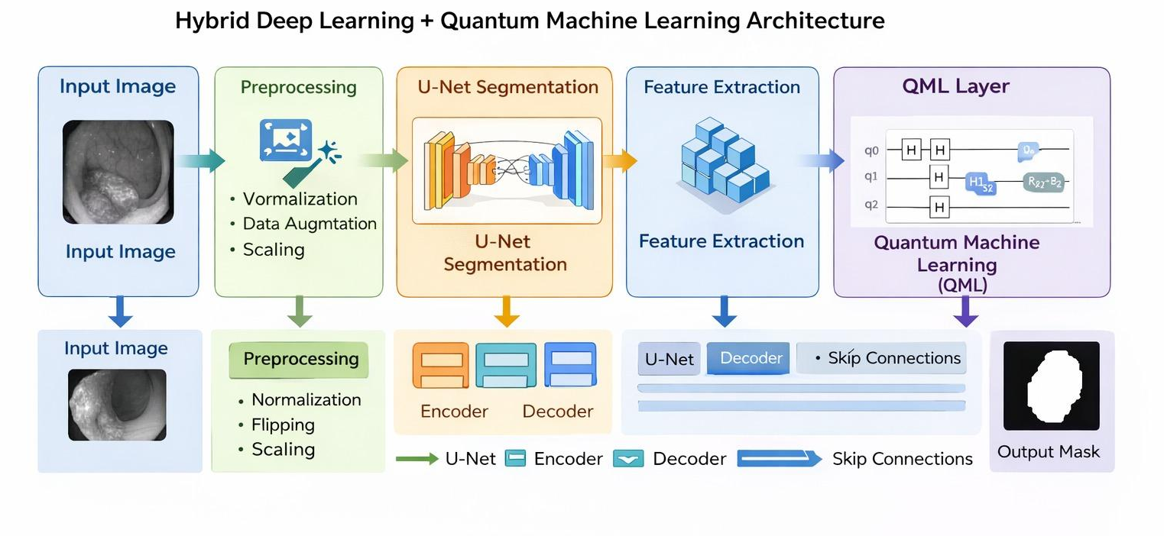
Proposed Solution
System Architecture / Model Diagram / Workflow / UML diagrams
‹#›

Slide 9
Proposed Solution
Key Components / Features / Modules
Dataset Module
Handles colonoscopy images and segmentation masks.
Preprocessing Module
Improves image quality and dataset diversity.
U-Net Module
Performs segmentation and feature extraction.
QML Module
Enhances feature representation using quantum circuits.
Segmentation Output Module
Generates final predicted masks.
‹#›

Slide 10
Proposed Solution
Algorithms / Technologies, Frameworks, and Tools Used
Algorithms Used
U-Net Architecture
Convolutional Neural Networks (CNN)
Variational Quantum Circuits (VQC)
Dice Loss Function
Adam Optimizer
Technologies and Frameworks
Python
TensorFlow / Keras
PennyLane
NumPy
OpenCV
Matplotlib
‹#›

Slide 11
Simulation and Results
Dataset Descriptions / Input – Output Descriptions
Dice Score 0.9161
IoU Score 0.8701
Pixel Accuracy 0.9874
Result Analysis
High overlap between predicted and actual masks.
Improved segmentation precision.
Strong boundary detection capability.
Stable convergence during training.
‹#›

Slide 12
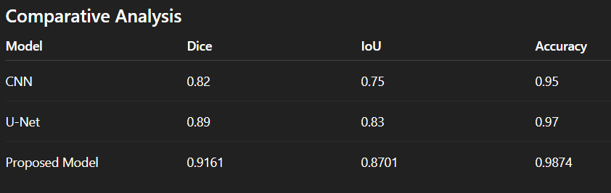
Simulation and Results
Parameters Descriptions (if any) / Initial Conditions
‹#›

Slide 13
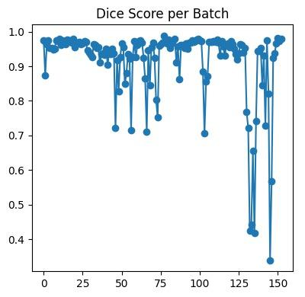
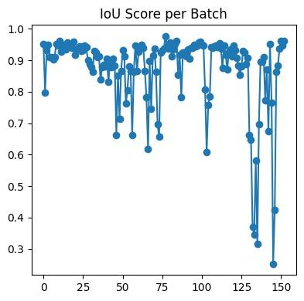
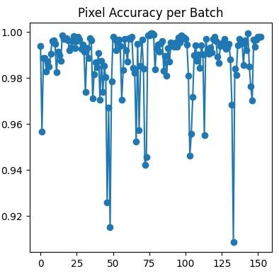
Simulation and Results
Implementation Outcomes ( Tables / Figures / User Interface Snaps)
‹#›

Slide 14
Summary
Key Findings
Hybrid U-Net + QML model achieved high segmentation accuracy.
Quantum feature enhancement improved precision and robustness.
Model generalized well across diverse samples.
Limitations
High computational complexity
Quantum simulation overhead
Hardware constraints
Future Directions
Real-time clinical deployment
Integration with advanced architectures
Deployment on real quantum hardware
‹#›

Slide 15
References
Slide 14 — References (APA Format)
Ronneberger, O., Fischer, P., & Brox, T. (2015). U-Net: Convolutional networks for biomedical image segmentation. In Proceedings of the International Conference on Medical Image Computing and Computer-Assisted Intervention (MICCAI) (pp. 234–241). Springer.
Jha, D., Smedsrud, P. H., Riegler, M. A., Halvorsen, P., de Lange, T., Johansen, D., & Johansen, H. D. (2020). Kvasir-SEG: A segmented polyp dataset. In Proceedings of the International Conference on Multimedia Modeling (MMM) (pp. 451–462). Springer.
Schuld, M., Sinayskiy, I., & Petruccione, F. (2020). An introduction to quantum machine learning. Nature, 549(7671), 195–202.
Esteva, A., Robicquet, A., Ramsundar, B., Kuleshov, V., DePristo, M., Chou, K., ... & Dean, J. (2019). A guide to deep learning in healthcare. Nature Medicine, 25(1), 24–29.
Long, J., Shelhamer, E., & Darrell, T. (2015). Fully convolutional networks for semantic segmentation. In Proceedings of the IEEE Conference on Computer Vision and Pattern Recognition (CVPR) (pp. 3431–3440).
He, K., Zhang, X., Ren, S., & Sun, J. (2016). Deep residual learning for image recognition. In Proceedings of the IEEE Conference on Computer Vision and Pattern Recognition (CVPR) (pp. 770–778).
Minaee, S., Boykov, Y., Porikli, F., Plaza, A., Kehtarnavaz, N., & Terzopoulos, D. (2021). Image segmentation using deep learning: A survey. IEEE Transactions on Pattern Analysis and Machine Intelligence, 44(7), 3523–3542.
Litjens, G., Kooi, T., Bejnordi, B. E., Setio, A. A. A., Ciompi, F., Ghafoorian, M., ... & Sánchez, C. I. (2017). A survey on deep learning in medical image analysis. Medical Image Analysis, 42, 60–88.

Slide 16

‹#›

